Slide 1
EMTH403
Mathematical Foundation for Computer Science

Slide 2
Lecture Outcomes
understand what are relations
understand what are the different properties of relation
understand what is reflexive, symmetric,

Slide 3
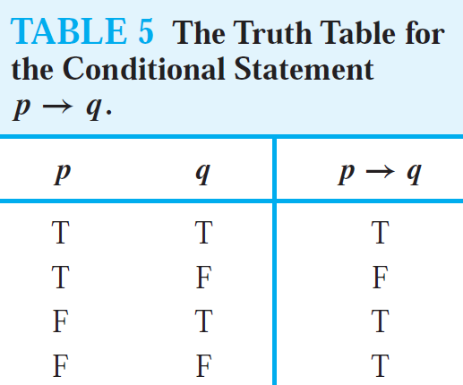
Binary Relation
Prerequisite:- Conditional Statement
Let A and B be sets. A binary relation from A to B is a subset of A × B.

Slide 4


Relation – Example
A B
Daughters
Mothers
Srishti
Ar. Sakshi
Manu
Dr. Seema
Joe
Prachi
Er. Diljeet
Relation={(Srishti, Dr. Seema), (Manu, Dr. Seema), (Joe, Ar. Sakshi), (Prachi, Er. Diljeet)}

Slide 5

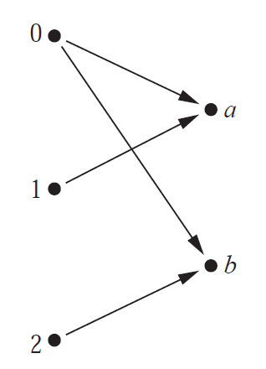
Binary Relation
Let A = {0, 1, 2} and B = {a, b}. Then {(0, a), (0, b), (1, a), (2, b)} is a relation from A to B.
This means, for instance, that 0R a, but that 1 b.
Relations can be represented graphically, as shown in Figure 1, using arrows to represent ordered pairs.

Slide 6
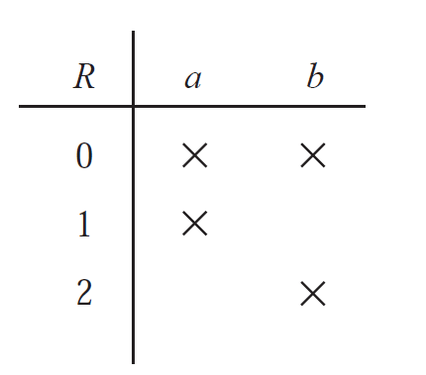
Binary Relation
Another way to represent this relation is to use a table, given below.

Slide 7
Relation
A relation on a set A is a relation from A to A.
In other words, a relation on a set A is a subset of A × A.

Slide 8
Relation
Ques:- Let A be the set {1, 2, 3, 4}. Which ordered pairs are in the relation R = {(a, b) | a divides b}?
Ans:- Because (a, b) is in R if and only if a and b are positive integers not exceeding 4 such that a divides b, we see that
R = {(1, 1), (1, 2), (1, 3), (1, 4), (2, 2), (2, 4), (3, 3), (4, 4)}.

Slide 9
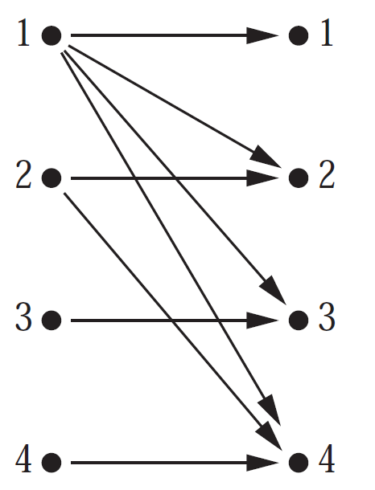
Relation
The pairs in this relation are displayed in graphically form. R = {(1, 1), (1, 2), (1, 3), (1, 4), (2, 2), (2, 4), (3, 3), (4, 4)}.

Slide 10
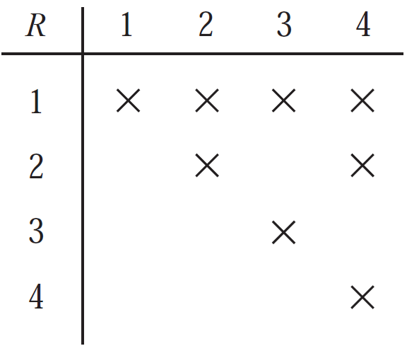
Relation
The pairs in this relation are displayed both in tabular form. R = {(1, 1), (1, 2), (1, 3), (1, 4), (2, 2), (2, 4), (3, 3), (4, 4)}.

Slide 11
Properties of Relations
Reflexive
Symmetric
Antisymmetric
Transitive

Slide 12
Properties of Relations – Reflexive
A relation R on a set A is called reflexive if (a, a) ∈ R for every element a ∈ A.
Remark: Using quantifiers we see that the relation R on the set A is reflexive if ∀a((a, a) ∈ R), where the universe of discourse is the set of all elements in A.

Slide 13
Properties of Relations – Reflexive
We see that a relation on A is reflexive if every element of A is related to itself.

Slide 14
Properties of Relations – Reflexive Example
Ques:- Consider the following relations on {1, 2, 3, 4}. Which of these relations are reflexive?
R1 = {(1, 1), (1, 2), (2, 1), (2, 2), (3, 4), (4, 1), (4, 4)}.
R2 = {(1, 1), (1, 2), (2, 1)}.
R3 = {(1, 1), (1, 2), (1, 4), (2, 1), (2, 2), (3, 3), (4, 1), (4, 4)}.
R4 = {(2, 1), (3, 1), (3, 2), (4, 1), (4, 2), (4, 3)}.
R5 = {(1, 1), (1, 2), (1, 3), (1, 4), (2, 2), (2, 3), (2, 4), (3, 3), (3, 4), (4, 4)}.
R6 = {(3, 4)}.

Slide 15
Properties of Relations – Reflexive Example
R1 = {(1, 1), (1, 2), (2, 1), (2, 2), (3, 4), (4, 1), (4, 4)}.
R2 = {(1, 1), (1, 2), (2, 1)}.
R3 = {(1, 1), (1, 2), (1, 4), (2, 1), (2, 2), (3, 3), (4, 1), (4, 4)}.
R4 = {(2, 1), (3, 1), (3, 2), (4, 1), (4, 2), (4, 3)}.
R5 = {(1, 1), (1, 2), (1, 3), (1, 4), (2, 2), (2, 3), (2, 4), (3, 3), (3, 4), (4, 4)}.
R6 = {(3, 4)}.
The relations R3 and R5 are reflexive because they both contain all pairs of the form (a, a), namely, (1, 1), (2, 2), (3, 3), and (4, 4). The other relations are not reflexive.

Slide 16
Properties of Relations – Reflexive Example 2
Ques:- Is the “divides” relation on the set of positive integers reflexive?
Ans:- Because a | a whenever a is a positive integer, the “divides” relation is reflexive.

Slide 17
Properties of Relations - Symmetric
A relation R on a set A is called symmetric if (b, a) ∈ R whenever (a, b) ∈ R, for all a, b ∈ A.
Remark: Using quantifiers, we see that the relation R on the set A is symmetric if
∀a∀b((a, b) ∈ R → (b, a) ∈ R).

Slide 18
Properties of Relations – Symmetric Example 1
Ques:- Consider the following relations on {1, 2, 3, 4}:
R1 = {(1, 1), (1, 2), (2, 1), (2, 2), (3, 4), (4, 1), (4, 4)}. Is it symmetric?
Ans:- R1 is not symmetric, because a pair (a, b) belongs to R1 but (b, a) is not.

Slide 19
Properties of Relations – Symmetric Example 2
Ques:- Consider the following relations on {1, 2, 3, 4}:
R2 = {(1, 1), (1, 2), (2, 1)}. Is it symmetric?
Ans:- R2 is symmetric

Slide 20
Properties of Relations – Symmetric Example 3
Ques:- Consider the following relations on {1, 2, 3, 4}:
R3 = {(1, 1), (1, 2), (1, 4), (2, 1), (2, 2), (3, 3), (4, 1), (4, 4)}. Is it symmetric?
Ans:- For R3, it is necessary to check that both (1, 2) and (2, 1) belong to the relation, and (1, 4) and (4, 1) belong to the relation.

Slide 21
Properties of Relations – Symmetric Example 4
Ques:- Consider the following relations on {1, 2, 3, 4}:
R4 = {(2, 1), (3, 1), (3, 2), (4, 1), (4, 2), (4, 3)}. Is it symmetric?
Ans:- One should verify that the relation is not symmetric. This is done by finding a pair (a, b) such that it is in the relation but (b, a) is not

Slide 22
Properties of Relations – Symmetric Example 5
Ques:- Consider the following relations on {1, 2, 3, 4}:
R5 = {(1, 1), (1, 2), (1, 3), (1, 4), (2, 2), (2, 3), (2, 4), (3, 3), (3, 4), (4, 4)}. Is it symmetric?
Ans:- One should verify that the relation is not symmetric. This is done by finding a pair (a, b) such that it is in the relation but (b, a) is not.

Slide 23
Properties of Relations – Symmetric Example 6
Ques:- Consider the following relations on {1, 2, 3, 4}:
R6 = {(3, 4)}. Is it symmetric?
Ans:- One should verify that the relation is not symmetric. This is done by finding a pair (a, b) such that it is in the relation but (b, a) is not.

Slide 24
Properties of Relations – Symmetric Example 7
Ques:- Is the “divides” relation on the set of positive integers symmetric?
Ans:-
This relation is not symmetric because 1| 2, but 2 | 1.

